Slide 1
ESQC 2024
Mathematical Methods Lecture 2
By Simen Kvaal

Slide 2

Where to find the material
SCAN ME
Alternative 1:
www.esqc.org, go to“lectures”
Find links there
Alternative 2:
Scan QR code
simenkva.github.io/esqc_material

Slide 3
Matrices
We pick up from last time

Slide 4
Matrices = linear transformations
Notes:
A(\mathbf{x})_i = \sum_{j=1}^n A_{ij} x_j
A = \begin{bmatrix} A_{11} & A_{12} & \cdots & A_{1n} \\
A_{21} & A_{22} & \cdots & A_{2n} \\
\vdots & \vdots & \ddots & \vdots \\
A_{m1} & A_{m2} & \cdots & A_{mn} \end{bmatrix}
A(\mathbf{x}) = \begin{bmatrix} A_{11} & A_{12} & \cdots & A_{1n} \\
A_{21} & A_{22} & \cdots & A_{2n} \\
\vdots & \vdots & \ddots & \vdots \\
A_{m1} & A_{m2} & \cdots & A_{mn} \end{bmatrix} \begin{bmatrix} x_1 \\ x_2 \\ \vdots \\ x_n\end{bmatrix}

Slide 5
Space of matrices
A matrix is a table
Vectors are also matrices!
# cols
# rows
Notes:
A \in \mathbb{F}^{m \times n} = M(m,n;\mathbb{F})

Slide 6
Matrix—matrix product
C(x) = A(B(x)) is a linear transformation, too.

Slide 7


Computing the matrix product
Also, since x is a matrix, we write
Notes:
\begin{bmatrix} A_{11} & A_{12} & \cdots & A_{1n} \\
A_{21} & A_{22} & \cdots & A_{2n} \\
\vdots & \vdots & \ddots & \vdots \\
A_{m1} & A_{m2} & \cdots & A_{mn} \end{bmatrix} \begin{bmatrix} B_{11} & B_{12} & \cdots & B_{1o} \\
B_{21} & B_{22} & \cdots & B_{2o} \\
\vdots & \vdots & \ddots & \vdots \\
B_{n1} & B_{n2} & \cdots & B_{no} \end{bmatrix} = \begin{bmatrix} C_{11} & C_{12} & \cdots & C_{1o} \\
C_{21} & C_{22} & \cdots & C_{2o} \\
\vdots & \vdots & \ddots & \vdots \\
C_{m1} & C_{m2} & \cdots & C_{mo} \end{bmatrix}

Slide 8



Important matrix operations
Transpose:
Hermitian adjoint:
Inner product as matrix product:
Notes:
(A^T)_{ij} = A_{ji} \qquad \begin{bmatrix} 0 & 1 \\ \rmi & 2 \\ 0 & -1 \end{bmatrix}^T = \begin{bmatrix} 0 & \rmi & 0 \\ 1 & 2 & -1 \end{bmatrix}

Slide 9
More on matrices
Matrices are very central to quantum chemistry and numerical methods in general

Slide 10
Examples of matrices working in 2D Euclidean space
Show Jupyter notebook
Lecture 2 – plane transformations.ipynb
Examples of: rotation, reflection, scaling

Slide 11
The structure of a matrix
A matrix has a set of columns
What happens if we compute Ax ?
A linear combination of the columns

Slide 13
Example
What is the column space of the identity matrix?
The columns are the standard basis vectors – a basis for 𝔽³
… so the column space should be 𝔽³ as well!
Arbitrary in 𝔽³

Slide 14
Systems of linear equations
A main problem in linear algebra
Let A ∈ 𝔽^{n⨉n}
System of linear equations:
When does this system have a unique solution?
Answer: When the matrix has rank n / col. space is a basis

Slide 15
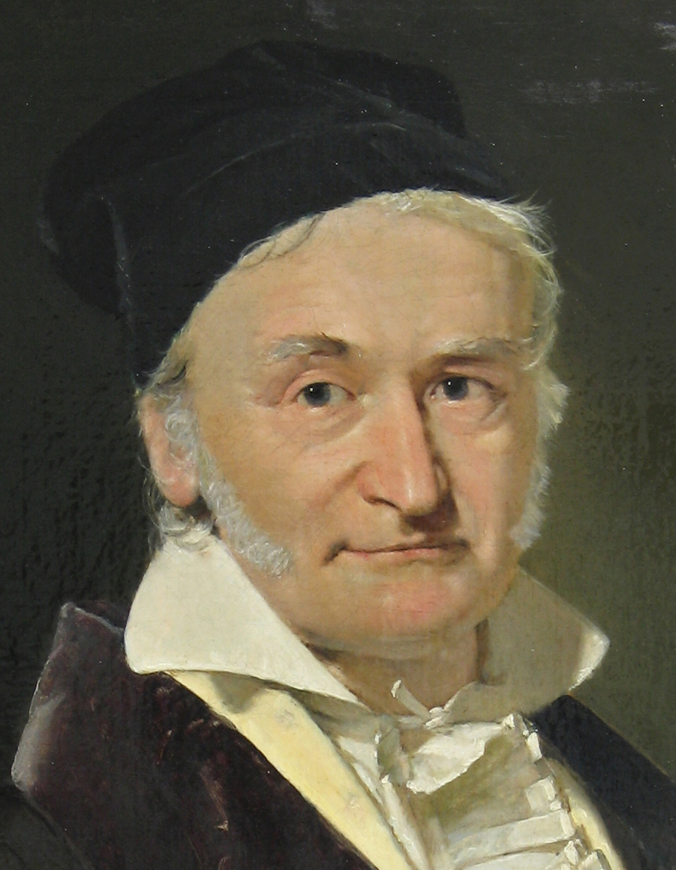
Gaussian elimination
Yes, almost everything is named after me, or should be
A method for solving linear systems
Read about it in the lecture notes!
Or watch some high-quality videos, e.g. https://www.youtube.com/watch?v=2GKESu5atVQ (MyWhyU)

Slide 16
Inverse matrix
Existence of unique solution gives inverse matrix
Example: Inverse of plane rotation matrix
Non-existence: Singular matrix A.
Inverse given by opposite rotation!

Slide 17
Example cont.

Slide 18
Special classes of matrices

Slide 19
Notation for n-dim Hilbert spaces

Slide 21
What’s so special about Hermitian A?
Only Hermitian operators have real diagonal matrix elements
In quantum mechanics, observables are modelled with operators.
Expectation value:
Thus observables must be Hermitian!

Slide 22
U preserves angles!

Slide 23
What characterizes a unitary matrix?
U is unitary if and only if the columns are orthonormal

Slide 24


What does a unitary matrix do?
U changes basis from standard basis to arbitrary orthonormal basis

Slide 25
Example
Rotation matrix

Slide 26
Matrix decompositions
Useful tools for characterizing and solving problems

Slide 27
Eigenvalue equation
Here posed as an “abstract” equation in Hilbert space
Central equation of quantum chemistry:
When a basis is introduced:
Can we find solutions? How many solutions?
Matrix eigenvalue problem (EVP)

Slide 29
POWERFUL!

Slide 30
Example
For example, useful for approximations of matrices
Show Jupyter notebook with SVD of bitmap image

Slide 31
General finite-dimensional vector spaces
With several examples

Slide 32



Space of polynomials
A basis, but no longer Euclidean space
dimension
Polynomials of degree ≤ n
A simple function space
Show: Jupyter notebook
Differentiation operator (n = 4)
derivative as a matrix!
Notes:
P_n = \left\{ f : [0,1] \to \mathbb{C} \mid f(x) = a_0 + a_1 x + a_2 x^2 + \cdots + a_n x^n, \; \mathbf{a} \in \mathbb{C}^{n+1} \right\}
D_{ji} = i \delta_{j,i-1}, \quad D = \begin{bmatrix} 0 & 1 & 0 & 0 & 0 \\ 0 & 0 & 2 & 0 & 0 \\ 0 & 0 & 0 & 3 & 0 \\ 0 & 0 & 0 & 0 & 4 \\ 0 & 0 & 0 & 0 & 0 \end{bmatrix}

Slide 33
Space of matrices
The space M(n) of square matrices (over some field) is a vector space
It is equal to 𝔽^{m} , m = n² dimensions
But we have an additional structure:
Vector space with vector-vector multiplication = algebra

Slide 34
A finite-dimensional C*-algebra
In the second-quant lectures,
We can consider an operator which is a polynomial
If N spin-orbitals: max N particles, so max degree is 2N
So a finite dimensional vector space of operators
Algebra: A vector space with a multiplication operation
Notes:
c_\ell \qquad c^\dag_k \qquad \{c_\ell, c^\dag_k \} = \delta_{\ell k}
+ \sum_{k\ell} \alpha_{k\ell} c_k c_\ell + \sum_{k\ell} \beta_{k\ell} c^\dag_k c_\ell + \sum_{k\ell} \gamma_{k\ell} c^\dag_k c^\dag_\ell

Slide 35
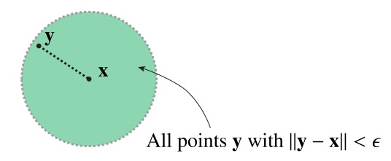
Inner product, norm
What these examples lack compared to Euclidean space:
A sense of distance
Euclidean space, as model of reality, comes with the intuition of which points are close to each other

Slide 36
General vector spaces
Vector space
(linear structure)
Euclidean space
Comes with linear structure + inner product
Mathematical abstraction
Topology,
e.g., inner product, norm, or metric
Other structures, e.g.,
multiplication

Slide 37
😬

Slide 38
In Euclidean space: the standard basis
Polynomials: the various x^{i}

Slide 39



Basis for finite-dimensional spaces

Slide 40
Example
The standard basis in Euclidean space:
The monomials in polynomial space:
A basis is never unique
Notes:
\mathbf{x} = \sum_{i=1}^n x_i \mathbf{e}_i
p(x) = \sum_{i=0}^n a_i x^i

Slide 41
Examples: bases in the plane
Standard basis, non-orthogonal basis, and not-a-basis

Slide 42
We will see this much later
A line through the origin
A plane through the origin
Polynomials without constant terms
Square integrable wavefunctions with finite kinetic energy

Slide 43
All finite dimensional vector spaces are isomorphic – the same
(… when it comes to the linear structure)
And linear transformations become …. matrices!
Action of operator in the given basis
Notes:
v = \sum_{i=1}^n x_i b_i\quad \longrightarrow \quad \mathbf{x} \in \mathbb{F}^n
\alpha v = \sum_{i=1}^n \alpha x_i b_i\quad \longrightarrow \quad \alpha \mathbf{x} \in \mathbb{F}^n
v_1 + v_2 = \sum_{i=1}^n ( x_{i1} + x_{i2} ) b_i\quad \longrightarrow \mathbf{x}_1 + \mathbf{x}_2 \in \mathbb{F}^n

Slide 44
Finite-dimensional Hilbert spaces
Finite dim vector space + inner product = Hilbert space

Slide 45
All finite-dimensional Hilbert spaces are the same
“overlap matrix”
… when an orthonormal basis is selected
Let V be a finite dim Hilbert space with given basis
Inner prod induces an inner product on
It is not the Euclidean inner product unless
Orthonormal basis
Notes:
\braket{v,v'} = \sum_{i=1}^n\sum_{j=1}^n \bar{x}_i \braket{b_i, b_j} x_j \equiv \mathbf{x}^H S \mathbf{x},

Slide 46
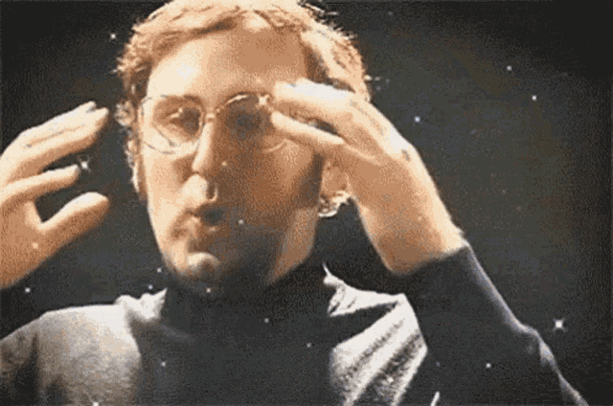

Slide 47
More on matrices
Matrices are very central to finite dimensional spaces

Slide 48
Examples of matrices working in 2D Euclidean space
Show Jupyter notebook

Slide 49
End of lecture 2
That’s it for today!

